Slide 1
Horizon Results Booster
Info Session | 17th of November 2022
Prepared by Alessia Melasecche Germini, HRB Manager

Slide 2
EU Research & Funding
Research
Results
Transforming project results into concrete benefits for the society, while maximising the scientific, social, economic, technological and policy value of the Framework Programmes, is a must.
This transformation passes through a successful implementation of Dissemination and Exploitation (D&E) activities.
Impact
D&E
Activities
Maximize
FPs Action
Notes:
Transforming project results into concrete benefits for the society, maximising the scientific, social, economic, technological and policy value of the Framework Programmes, is a must.
This transformation passes through the successful of Dissemination and Exploitation implementation (D&E) activities.

Slide 3
The Benefits
Successful D&E activities can pave the way to various tangible benefits:
Providing international and interdisciplinary collaboration opportunities;
Contributing to societal goals;
Attracting new talent to join your teams;
Improving access to other funding prospects;
Generating new sources of income thanks to the exploitation of the results;
In the case of policy impact, improving current and/or help shaping future legislation.

Slide 4
The Opportunity
The Horizon Results Booster (HRB) is the initiative of DG RTD
which aims to maximise the impact
of research projects funded by FP7, H2020 and Horizon Europe.

Slide 5
The Horizon Results Booster
HRB services delivered to eligible projects (closed and ongoing) are free-of-charge and fully supported by the EC.
Services can be requested by applicants “à la carte” from the list when completing the application form.
HRB provides beneficiaries with tools and methodologies. Experts act as facilitators. Service delivery happens remotely and virtually.

Slide 6
Service 1
Service 2
Service 3
Portfolio Dissemination & Exploitation Strategy
Business Plan Development
Go To Market

Slide 7
Service Eligibility and Requirements
Service 1 - Portfolio Dissemination & Exploitation Strategy (PDES)
Service 1 - Portfolio Dissemination & Exploitation Strategy (PDES)
Dissemination Services
Services Flow
Module A
Module C
Assisting projects to improve existing exploitation strategy
Single projects
Identification and creation of the portfolio of R&I
project results
Single projects
Exploitation plan optional
Exploitation Services
Project groups (PGs)
Focus on 3 KERs
Module B
Service 2 – Business Plan Development (BPD)
Portfolio Dissemination
Plan (design & execution)
Project groups (PGs)
Single projects
Exploitation plan / Business plan required
Focus on 1 KER only
Portfolio of results
Service 3 – Go-To-Market Support (GTM)
Dissemination services and Exploitation services can run in parallel and are delivered by different experts.
Single projects & PGs
Focus on 1 KER only
6 packages available*
Business plan required

Slide 8
Why Should Projects Benefit From HRB Services?
Achieving Impact (on society and/or market) and long-term sustainability strictly depends on D&E strategies and actions.
Experiences from the delivery:
Wrong identification of Key Exploitable Results
Confusion between customers, end-users and partners
Use model not identified, etc.
It is important to dedicate the right effort and time to exploitation and uptake of research results.
Wrong basics generate wrong strategies!

Slide 9
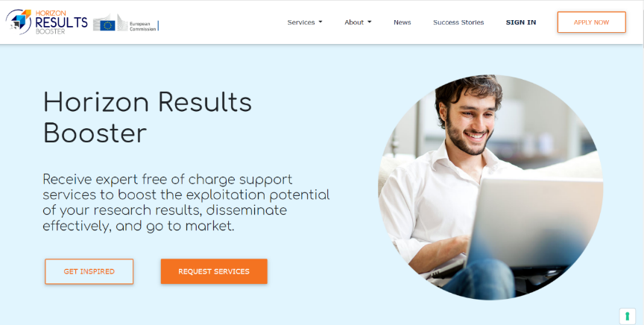
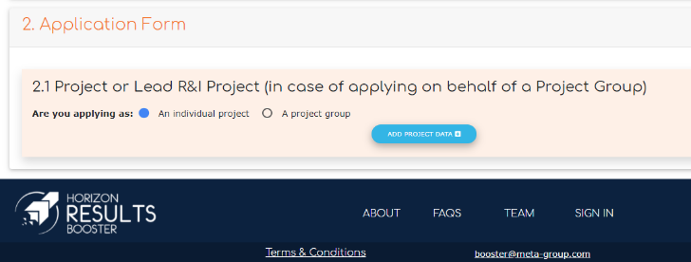
How Can Projects Apply? (1/2)
Application is public and open to eligible projects
Request for services: click on the “request services” button on the website
Fill out the application form (direct access through: https://www.horizonresultsbooster.eu/HRBApplications/ApplicationForm)

Slide 10
How Can Projects Apply? (2/2)
Beneficiaries have to register first on the HRB platform to submit an application.
To apply they need to provide:
- Project ID (GA number)
- Name and e-mail of the applicant
- Name and e-mail of the project coordinator
- Name and e-mail of the PO
They can save draft applications and continue whenever they want before submitting
During the application, specific questions are asked, and documents have to be uploaded based on the service requested
Alerts keep applicants informed about their “readiness” for the requested service

Slide 11
What Happens After the Submission?
1
Eligibility of applications (minimum requirements, application to the same service, projects too far in the past, etc.) is verified by the HRB Team (EC)
2
Experts are proposed by the Contractor and accepted/rejected by HRB Team (EC)
3
The expert organises a “preliminary call” to define the Service Delivery Plan
4
If the experts realise the projects are not “ready” for the service, they propose another service
5
Feedback questionnaires are proposed at the end of the service to verify effectiveness
6
Outputs, deliverables and final reports of the services are saved in the platform
7
Automatic e-mail alert (to the EC too) when the final report is uploaded onto the platform.

Slide 12
What Happens During the Delivery?
Average amount of efforts from beneficiaries:
Service 1 Module A:
Around 1 EWD (around 8 hours spread on multiple days)
Service 1 Module B:
From 2 to 4 EWDs (depending on the training package selected during the service)
Service 1 Module C, BPD, G2M:
A range from 3 to 10 EWDs (depending on the level of maturity of the project)
Time commitment by project partners to HRB services could be reported in project timesheets.

Slide 13
HRB in Numbers as of November 2022 (1/2)
194
Experts involved
875
Projects
941
Assignments
2.469
Beneficiaries
6.556
Organisations

Slide 14
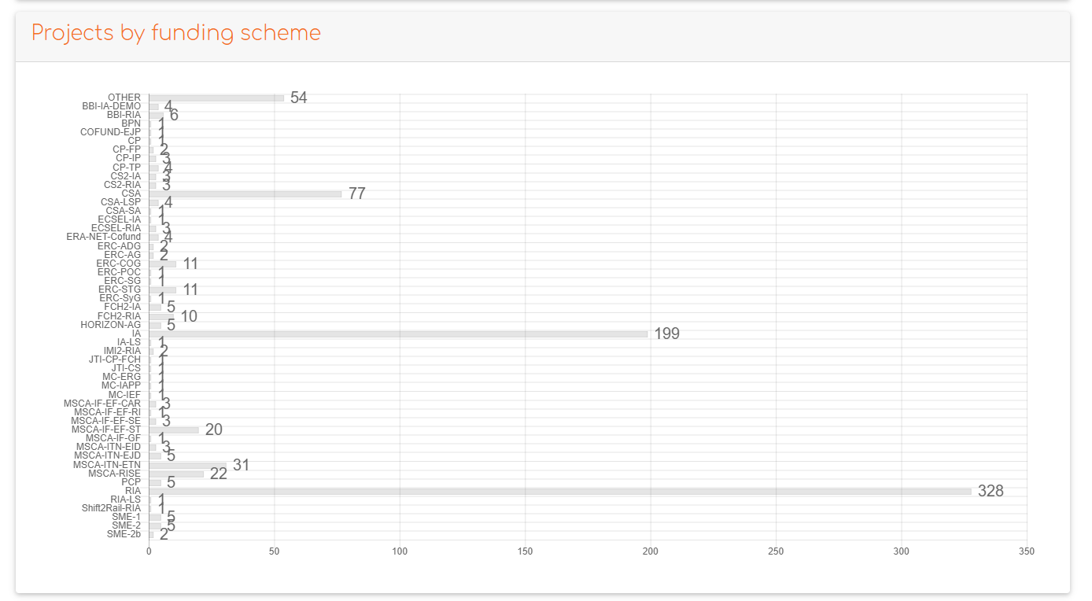
HRB in Numbers as of November 2022 (2/2)

Slide 15
Alessia Melasecche Germini
booster@meta-group.com
www.horizonresultsbooster.eu

